Slide 1
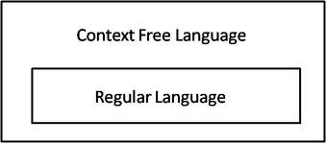
Context-Free Languages
Course Instructor: Dr. Sohail Iqbal
Book: Prof. Sipser-MIT
Slides: Prof. Busch - LSU

Slide 2
Recap: PDA
PDA :

Slide 3
Context-Free Languages
Regular Languages
A CFG is related to PDA?
Yes!

Slide 4
Context-Free Languages
Context-Free
Grammars
Pushdown
Automata
stack
automaton

Slide 5
Context-Free Grammars

Slide 6
Grammar:
Derivation of string :

Slide 7
Grammar:
Derivation of string :

Slide 8
Derivation Order and Derivation Trees

Slide 9
Derivation Order
Consider the following example grammar
with 5 productions:

Slide 10
Leftmost derivation order of string :
At each step, we substitute the
leftmost variable

Slide 11
Rightmost derivation order of string :
At each step, we substitute the
rightmost variable

Slide 12
Leftmost derivation of :
Rightmost derivation of :

Slide 13
Derivation Trees
Consider the same example grammar:
And a derivation of :

Slide 14
yield

Slide 15
yield

Slide 16
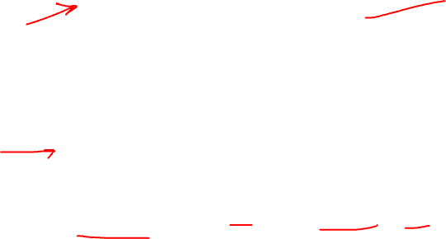
yield

Slide 17
yield

Slide 18
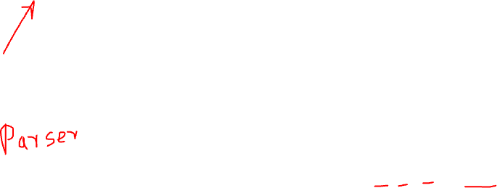
Derivation Tree
(parse tree)
yield

Slide 19
Sometimes, derivation order doesn’t matter
Leftmost derivation:
Rightmost derivation:
Give same
derivation tree

Slide 20

Ambiguity

Slide 21
Grammar for mathematical expressions
Example strings:
Denotes any number

Slide 22
A leftmost derivation
for

Slide 23
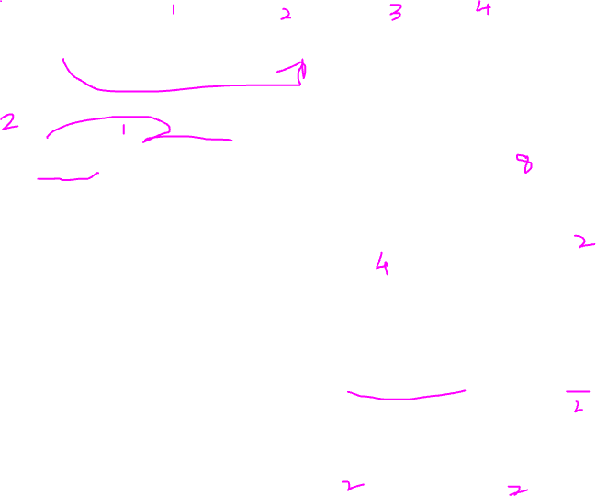
Another
leftmost derivation
for

Slide 24
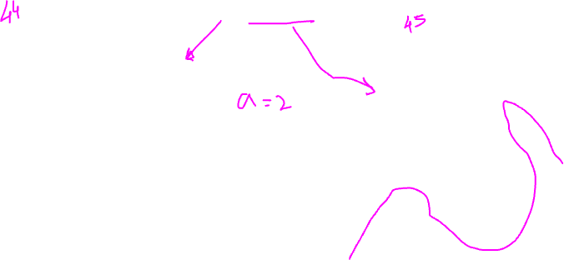
Two derivation trees
for

Slide 25
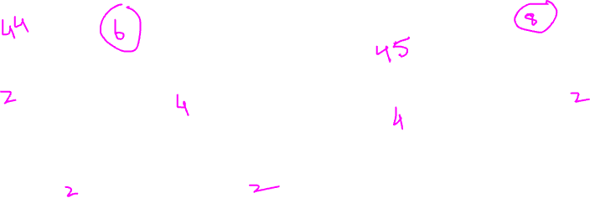
take

Slide 26

Good Tree
Bad Tree
Compute expression result
using the tree

Slide 27

Two different derivation trees
may cause problems in applications which
use the derivation trees:
Evaluating expressions
In general, in compilers
for programming languages

Slide 28
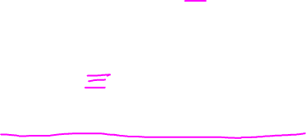
Ambiguous Grammar:
A context-free grammar is ambiguous
if there is a string which has:
two different derivation trees
or
two leftmost derivations
(Two different derivation trees give two
different leftmost derivations and vice-versa)

Slide 29
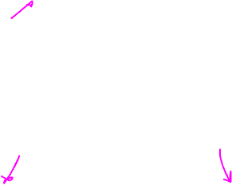
Example:
this grammar is ambiguous since
string
has two derivation trees

Slide 30
this grammar is ambiguous also because
string
has two leftmost derivations

Slide 31
Another ambiguous grammar:
IF_STMT
if EXPR then STMT
if EXPR then STMT else STMT
Variables
Terminals
Very common piece of grammar
in programming languages

Slide 32

If expr1 then if expr2 then stmt1 else stmt2
IF_STMT
if
expr1
then
STMT
if
expr2
then
stmt1
else
stmt2
Two derivation trees
IF_STMT
if
expr1
then
STMT
else
stmt2
if
expr2
then
stmt1

Slide 33
In general, ambiguity is bad
and we want to remove it
Sometimes it is possible to find
a non-ambiguous grammar for a language
But, in general ιt is difficult to achieve this

Slide 34
A successful example:
Equivalent
Ambiguous
Grammar
Non-Ambiguous
Grammar
generates the same
language

Slide 35
Unique
derivation tree
for

Slide 36
Some Application Area of Context Free Languages
Natural Language understanding (AI)
Formulation of New Programming Languages
Compiler Construction and Optimization

Slide 37
Thank You !

